Slide 1
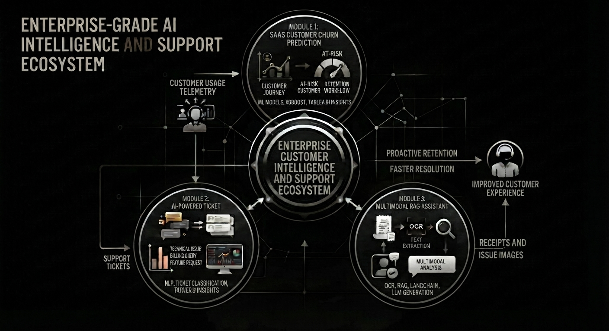
An End-to-End AI-Driven Pipeline for Customer Churn Prediction, Support Ticket Analytics, and Multimodal RAG Assistance
Presented by: Gozail Yousaf Butt

Slide 2
Overview and Problem Statement
What does the project do? It combines three powerful systems to analyze customer behavior, automatically categorize and triage support tickets, and provide an advanced multimodal RAG assistant for resolving complex customer issues and receipts.
Why was it built? Modern SaaS businesses face massive revenue loss due to customer churn, high volumes of unmanaged support tickets, and slow manual resolution times for visual or receipt-based issues
How does it solve the problem? It links predictive analytics (churn forecasting) with automated NLP ticket sorting and real-time multimodal retrieval (OCR + LLMs).

Slide 3
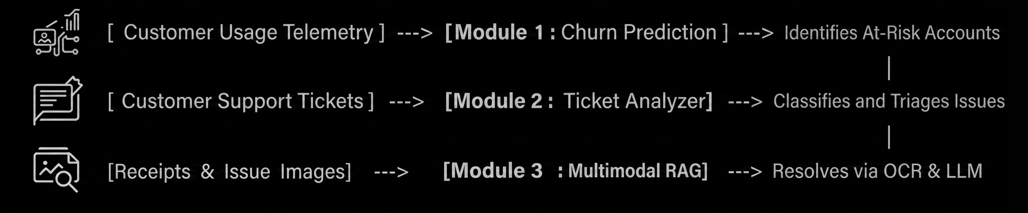
System Design and Collective Architecture
How the 3 Projects Link Together:
Module 1 (SaaS Churn Prediction): Monitors customer usage data and flags vulnerable accounts at risk of leaving
Module 2 (Ticket Analyzer): When dissatisfied customers raise complaints, this module automatically categorizes and prioritizes incoming support tickets using NLP
Module 3 (Multimodal RAG-Assistant): For complex technical issues, broken product screenshots, or receipts attached to those tickets, the RAG assistant processes visuals via OCR and provides instant solutions.

Slide 4
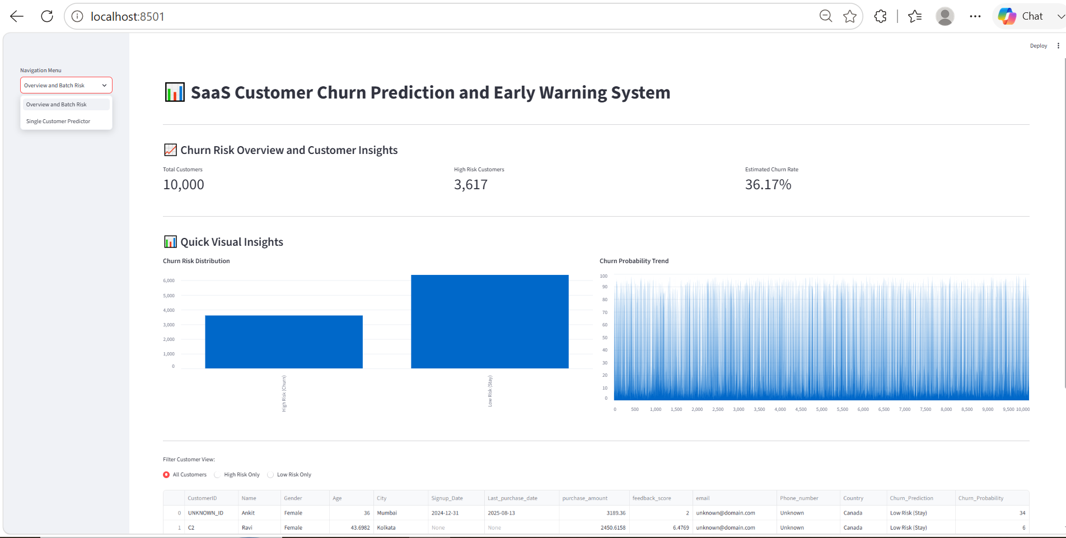
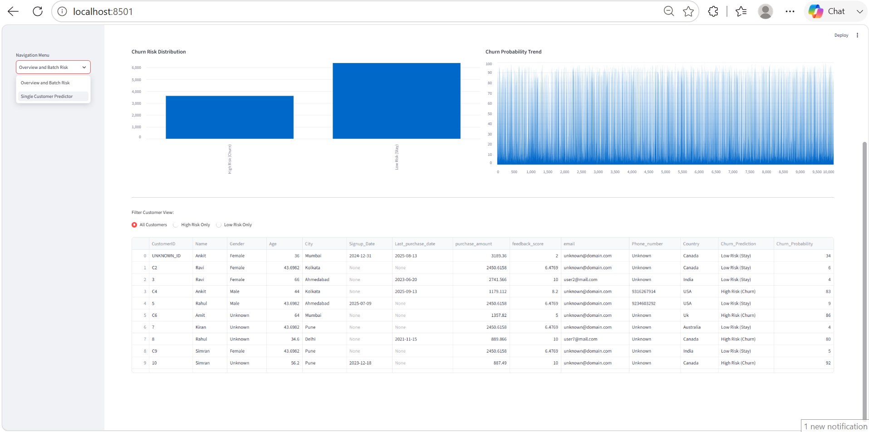
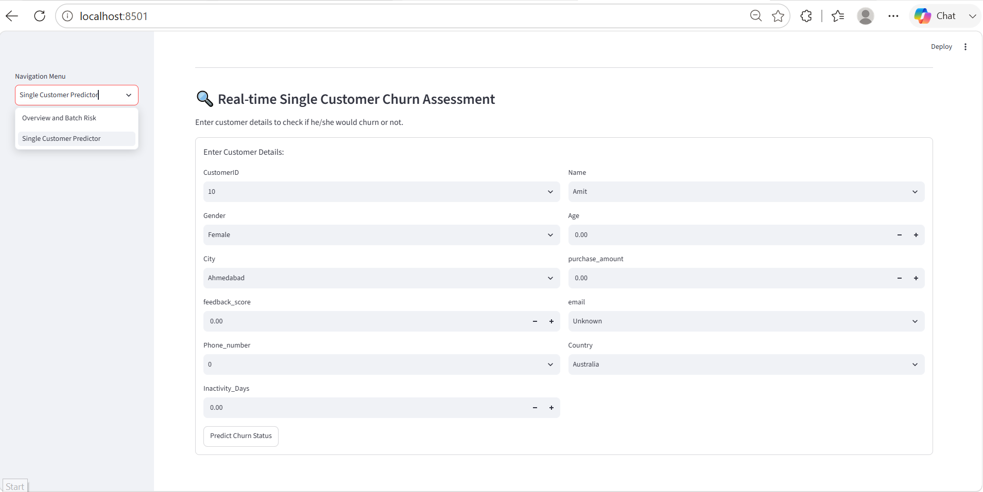
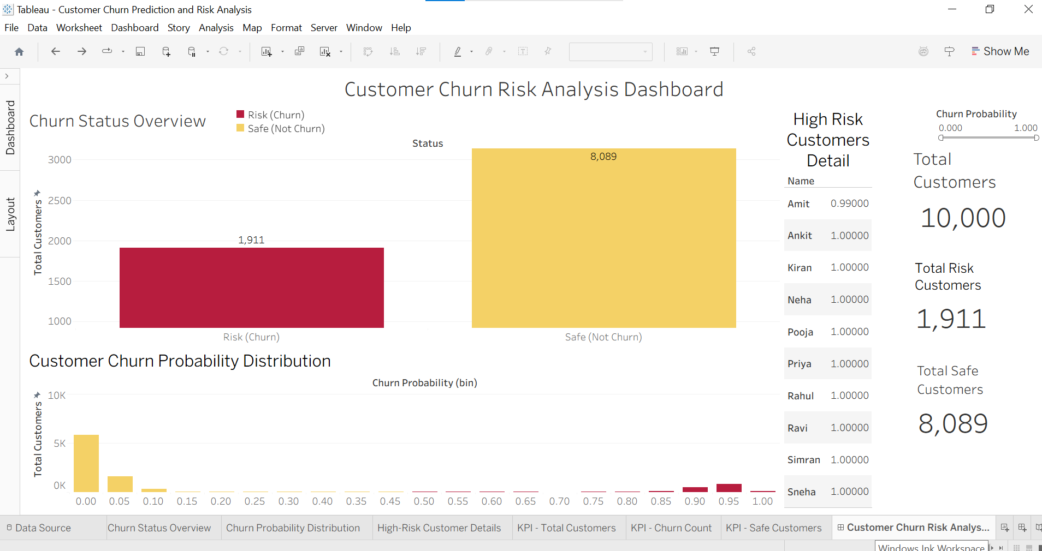
Module 1 - SaaS Customer Churn Prediction
Core Function: Processes customer usage data and account behaviors to forecast churn risks in real-time
Key Components:
Automated data preprocessing pipelines and missing value handling
Model serialization using Joblib for instant inference.
Tableau visual workspaces for retrospective data analysis alongside application logic

Slide 5
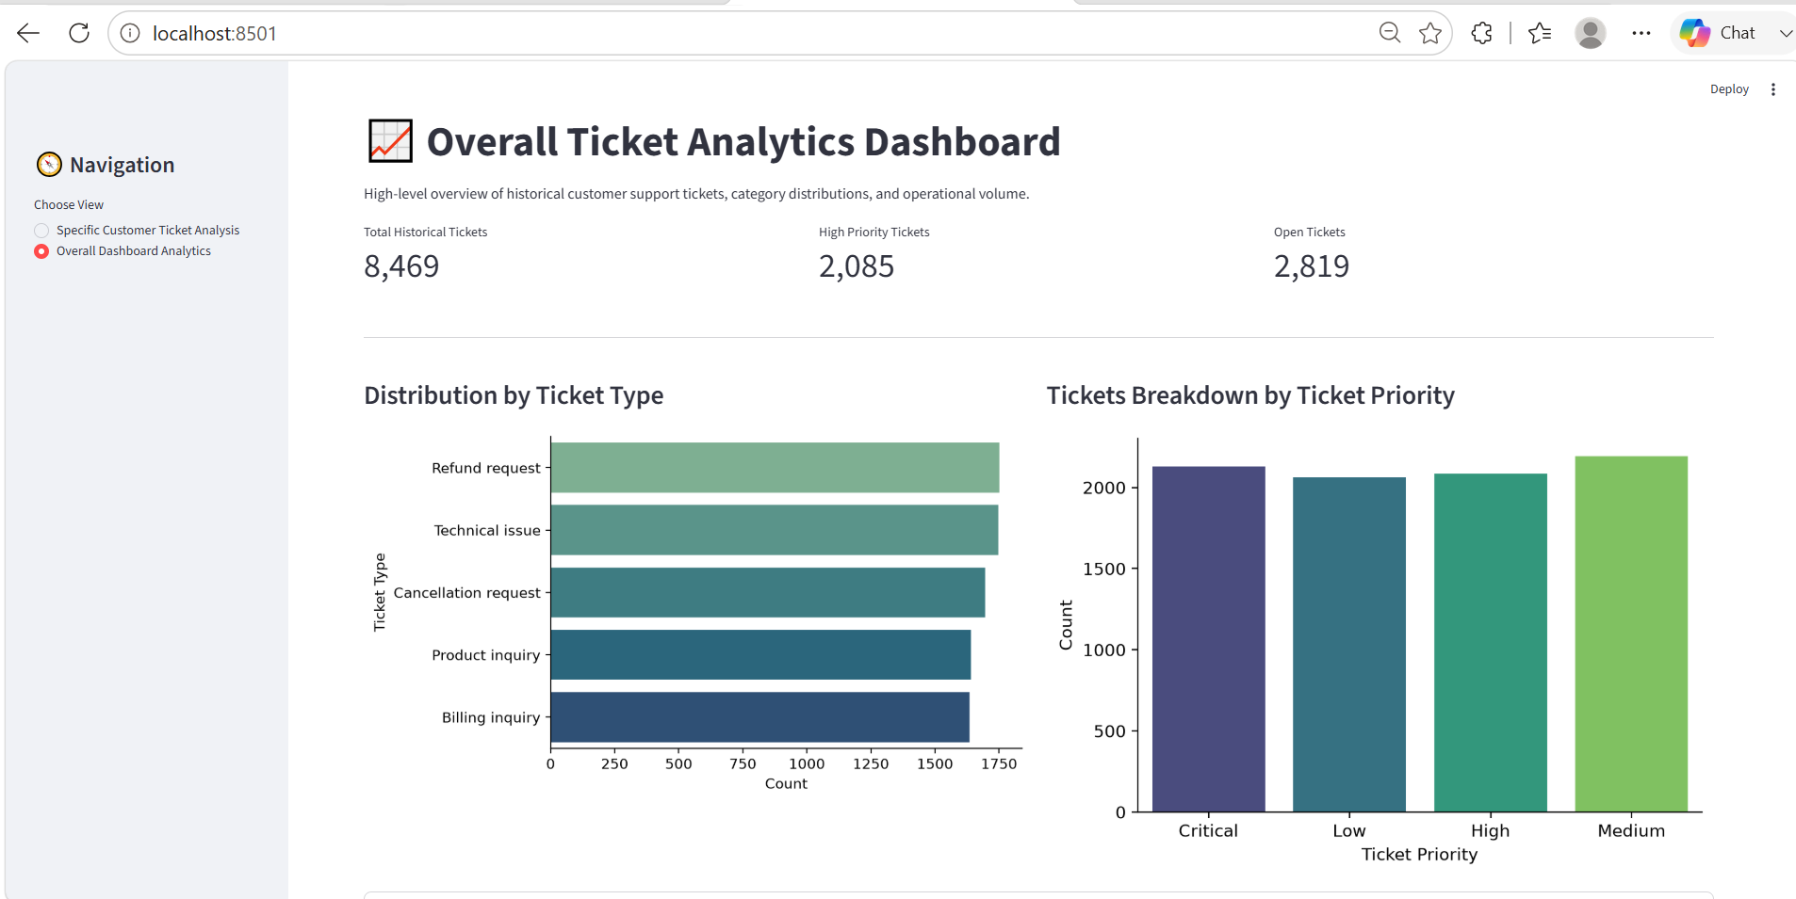
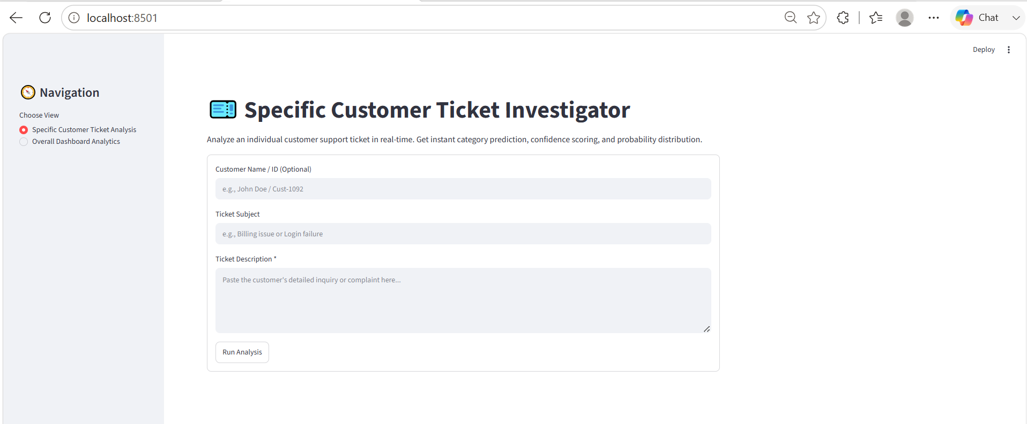
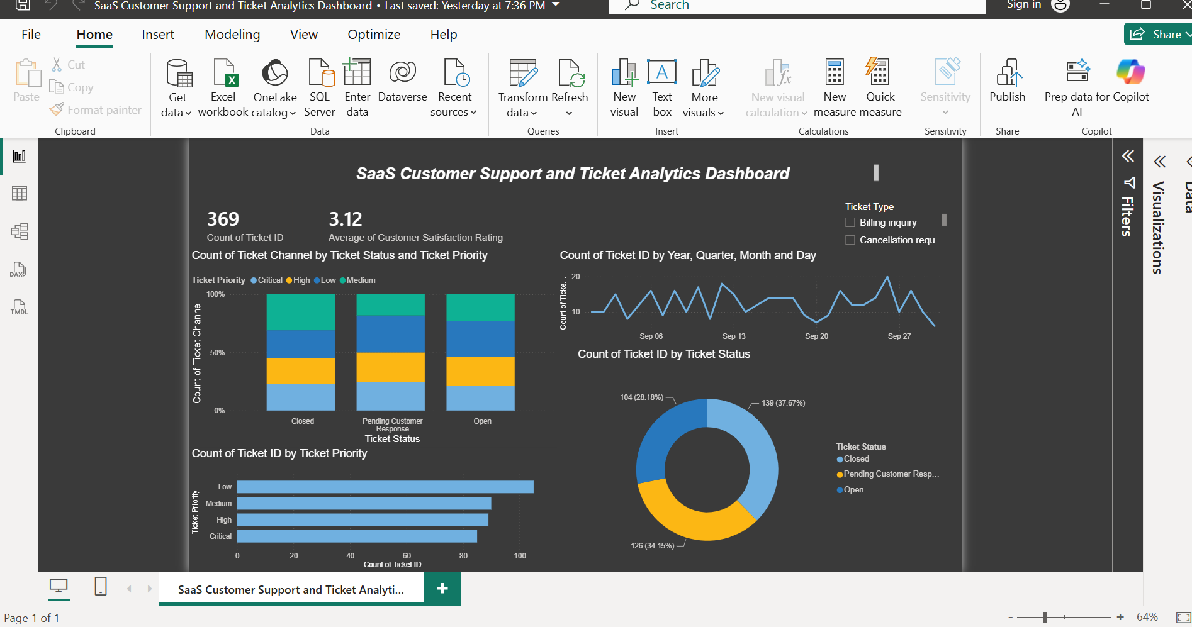
Module 2 - Support Ticket Analyzer
Core Function: Automates customer support ticket categorization and NLP analytics
Key Components:
Uses machine learning classification pipelines and natural language processing
Predicts ticket categories using pre-trained classifiers
Power BI visual dashboards for comprehensive support and ticket metrics.

Slide 6
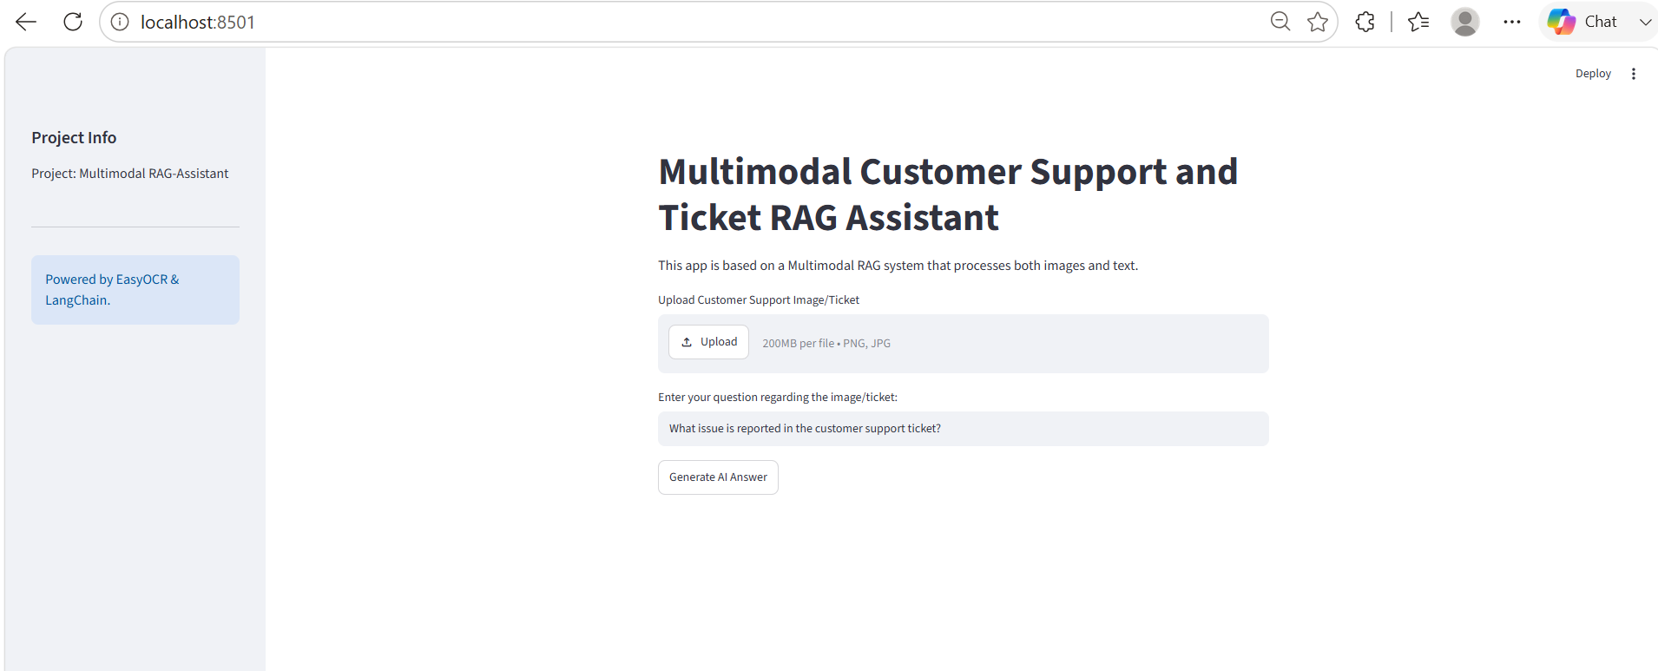
Module 3 - Multimodal RAG-Assistant
Core Function: In-memory multimodal RAG system processing textual documents and visual inputs (receipts/screenshots).
Key Components:
OCR Processing: Utilizes to extract clean text data from customer images automatically.
Retrieval Engine: Efficiently indexes text chunks and OCR data
Generation: Powered by Hugging Face Transformers and Sentence-Transformers.

Slide 7
Consolidated Tech Stack
Core Language: Python 3.8+
Data Manipulation & Computing: Pandas, NumPy
Machine Learning & NLP: Scikit-Learn, XGBoost, NLTK, Joblib
Deep Learning & RAG: PyTorch, Transformers, Sentence-Transformers, LangChain
Computer Vision & OCR: OpenCV, Pillow, EasyOCR
Dashboards & Deployment: Streamlit, Tableau, Power BI, Docker

Slide 8
Getting Started and Usage
Installation Protocol:
Run pip install –r requirement.txt inside each respective project directory.
Execution Command:
Launch individual dashboards locally using Streamlit: streamlit run app/app.py
Project Structure Hierarchy:
Organized modular structure with separate folders for app, data, model, notebooks, src , README and Dockerfile across al tree modules

Slide 9
Conclusion Summary: A scalable, modular, and integrated ecosystem addressing customer retention, support triage, and multimodal query resolution.

